Slide 1
Computer Architecture 计算机体系结构
School of Computer and Information Technology Beijing Jiaotong Univeristy
Yi Tian

Slide 2
课程概况
1. 共48学时(24次课)。其中课堂讲授32学时(18次课左右)，实验16学时(6次课左右)。
2. 平时包括考勤、课堂表现、测验、上机作业。
3. 最终有期末考试，开卷。英文试卷。
4. 考核方式：平时约50%，期末约50%。
5. 要求尽量读懂教材的英文原文。
6. 联系方式：
①课程平台： https://bksy.bjtu.edu.cn/index.html
②tianyi@bjtu.edu.cn。注意：务必标上你的学号，姓名。
③课程微信群。

Slide 3

课程概况
课程微信群。重要！！！
群备注：姓名-学号，例如：张三-11112222

Slide 4
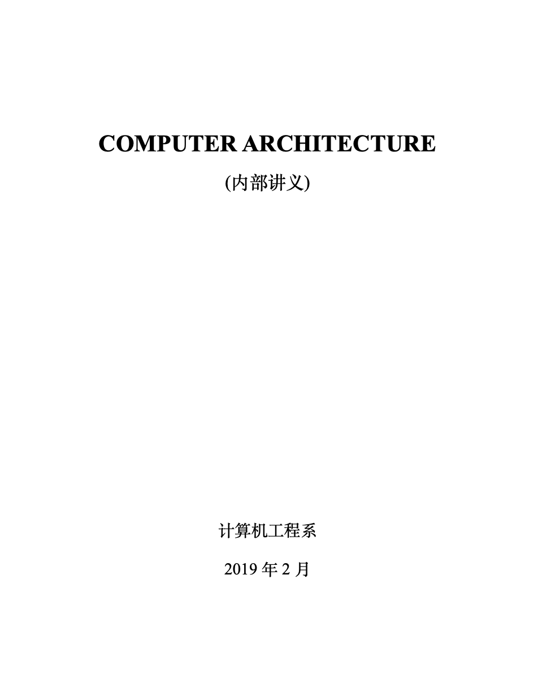
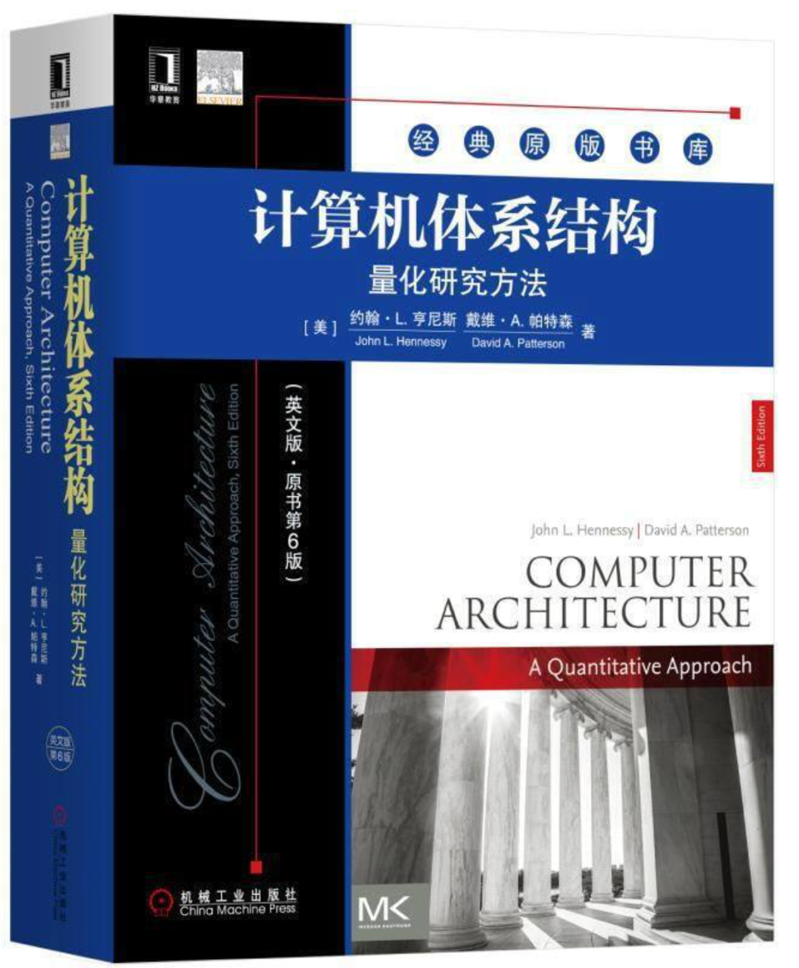
课程概况
学习资料：
英文讲义（重要）；
上课PPT （重要，课后更新） ；
中文参考书（供参考）；
其它参考书（供参考） 。
John L. Hennessy
David A. Patterson

Slide 5
课程概况
学习要求及目标：
全局思维；
查阅资料；
认真听课，认真复习，认真完成作业；
理论联系实际。

Slide 6
Contents
Chapter 1. Fundamentals of Computer Architecture
第一章 计算机体系结构的基本原理
Chapter 2. Instruction Set Architecture
第二章 指令集结构
Chapter 3. Pipelining
第三章 流水线
Chapter 4. Memory Hierarchy
第四章 存储层次

Slide 7
Chapter 1. Fundamentals of Computer Architecture 计算机体系结构的基本原理

Slide 8
Chapter 1 Fundamentals of Computer Architecture
1.1 Layers of Computer System
1.2 Computer Architecture and Implementation
1.3 The Task of A Computer Designer
1.4 Measuring and Reporting Performance
1.5 Quantitative Principles of Computer Design
1.6 Classification of Computer Architecture

Slide 9
1.1 Layers of Computer systems
从计算机语言的角度，把计算机系统按功能划分成多级层次结构，以对整个系统进行描述、分析、设计和使用。

Slide 10
1.1 Layers of Computer systems
Application Language Machine M5 应用语言机
High-Level Language Machine M4 高级语言机
Assembly Language Machine M3 汇编语言机
Operating System Machine M2 操作系统机
Conventional Machine M1 传统机
Microprogram Machine M0 微程序机

Slide 11
1.1 Layers of Computer systems
计算机语言可以说是一种虚拟的计算机系统
计算机语言由低级向高级发展，高一级语言的语句相对于低级语言功能更强，更便于应用，但又都以低级语言为基础。
对于用某一层语言编写程序的程序员来说，似乎有了一种新的机器，该机器能执行用该层语言写的全部程序。

Slide 12
1.1 Layers of Computer systems
M0 微程序机
是指具体存在的硬件层次，它执行机器指令，可以看做是指令系统层指令的解释器。
由微程序控制的计算机，微程序就是上一层指令的解释器。在硬件直接控制的计算机上，是由硬件直接解释执行指令。
Application Language Machine M5
High-Level Language Machine M4
Assembly Language Machine M3
Operating System Machine M2
Conventional Machine M1
Microprogram Machine M0

Slide 13
1.1 Layers of Computer systems
M1 传统机
是机器语言程序员眼中所看到的计算机，这一层也称为指令系统层。主要特征就是指令系统。
指令系统规定了由硬件实现的各种指令功能。
各种源程序必须通过编译器或者解释器转换为硬件能够识别与执行的指令序列。
Application Language Machine M5
High-Level Language Machine M4
Assembly Language Machine M3
Operating System Machine M2
Conventional Machine M1
Microprogram Machine M0

Slide 14
1.1 Layers of Computer systems
M2 操作系统机
从系统程序员的观点来看，操作系统层指令集包括指令系统层的指令和新增的指令。
新增的指令称为系统调度。
Application Language Machine M5
High-Level Language Machine M4
Assembly Language Machine M3
Operating System Machine M2
Conventional Machine M1
Microprogram Machine M0

Slide 15
1.1 Layers of Computer systems
M3 汇编语言机
每一种计算机都有一套自己的汇编语言、翻译它的汇编器，以及相应的程序设计与开发方法。
汇编语言程序通过汇编器翻译或解释成机器语言，在操作系统的安排下再由微体系结构层执行。
Application Language Machine M5
High-Level Language Machine M4
Assembly Language Machine M3
Operating System Machine M2
Conventional Machine M1
Microprogram Machine M0

Slide 16
1.1 Layers of Computer systems
M4 高级语言机
高级语言层通常是为了解决现实问题的应用程序员使用的，例如Java，C，C++等。
一般将编写的程序翻译成M3或者M2层语言，偶尔也直接解释执行。
Application Language Machine M5
High-Level Language Machine M4
Assembly Language Machine M3
Operating System Machine M2
Conventional Machine M1
Microprogram Machine M0

Slide 17
1.1 Layers of Computer systems
M5 应用语言机
是为了使计算机满足某种用途而专门设计的，因此该级语言就是面向具体应用问题的应用语言。
一般翻译成高级语言。
Application Language Machine M5
High-Level Language Machine M4
Assembly Language Machine M3
Operating System Machine M2
Conventional Machine M1
Microprogram Machine M0

Slide 18
1.1 Layers of Computer systems
Application Language Machine M5
虚拟机器（virtual machine）：由软件实现的机器。
High-Level Language Machine M4
Translation
翻译
Assembly Language Machine M3
Operating System Machine M2
实际机器（actual machine）：由硬件或固件实现的机器。
Conventional Machine M1
Interpretation
解释
Microprogram Machine M0

Slide 19
1.1 Layers of Computer systems
Tips: 语言实现的基本技术
Translation 翻译：把N+1级程序全部转换成N级程序后，再去执行新产生的N级程序，在执行过程中N+1级程序不再被访问。
例如：英语翻译。
多占存储空间，不占运行时间。
高级语言程序通常要先编译。
Interpretation 解释：每当一条N+1级指令被译码后，就直接去执行一串等效的N级指令，然后再去取下一条N+1级的指令，依次重复执行。
例如：同声传译。
节省存储空间，运行费时。

Slide 20

1.2 Computer Architecture and Implementation
What’s Computer Architecture?
1964年C. M. Amdahl在介绍IBM 360系统时提出经典的计算机体系结构（Computer Architecture）定义。

Slide 21
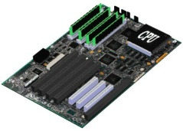
1.2 Computer Architecture and Implementation
软件
指令集（Instruction set）
硬件
经典计算机体系结构概念的实质是计算机系统中软硬件界面的确定，其界面之上的是软件的功能，界面之下的是硬件和固件的功能。“指令集结构”

Slide 22
1.2 Computer Architecture and Implementation
软件和硬件的逻辑等效性
由软件实现的功能在原理上可以由硬/固件实现。同样，由硬件实现的功能原理上也可以由软件的模拟方法来实现。
软件和硬件的性能价格比是不等效的。
对于计算机系统软硬件功能分配应保证在满足应用的前提下，充分利用硬件、器件、软件技术，使系统达到较高的性能价格比。

Slide 23
1.2 Computer Architecture and Implementation
♦ Computer Architecture: Refers to those attributes of a system visible to a programmer, or those attributes have direct impact on logical execution of program.
程序员可见，或者对程序执行有直接影响的属性。
♦ Previously，computer architecture often referred to instruction set design. Other aspects of computer design were called implementation. 以前仅指指令集设计，其余的设计方面称为实现。

Slide 24
1.2 Computer Architecture and Implementation
The implementation of a machine has two components: Organization and Hardware.
Organization（组织）: includes high-level aspects of a computer’s design, such as: memory system, bus structure, internal CPU.
Two processors may have the same instruction set architectures but different organizations. 相同的指令集体系结构可有不同的组织
Hardware（硬件）: refers to the specifics of a machine, include: detailed logic design and packaging technology.
Computers with identical instruction set architectures may have nearly identical organizations, but they differ in the detailed hardware implementation. 相同的指令集体系结构和组织在硬件实现上可不同。

Slide 25
1.2 Computer Architecture and Implementation
Architectural Attributes 系统结构方面的属性
♦ instruction set, 指令集
♦ I/O mechanisms, I/O机制
♦ techniques for addressing memory 寻址技术
Organizational Attributes 组织方面的属性
Hardware details transparent to the programmer.
control signals 控制信号
computer/peripheral interfaces 计算机/外设接口
memory technology 存储技术
Hardware Attributes 硬件方面的属性
♦ packaging technology 封装技术
♦ power 电源
♦ cooling 冷却

Slide 26
1.2 Computer Architecture and Implementation
Tips:
Transparent (透明性)：在计算机技术中，对这种本来是存在的事物或属性，但从某种角度看又好像不存在的概念称为透明性。
通常低层机器的属性对高层机器程序员往往是透明的。
例如，数据总线宽度等对计算机维护人员不透明，非常清楚。对汇编语言程序员是透明的。指令系统对C语言程序员是透明的。

Slide 27
1.2 Computer Architecture and Implementation
示例:
Whether a computer will have a multiply instruction？确定是否有乘法指令属于？
Whether the instruction will be implemented by a special multiply unit or by repeated use of the add unit？乘法指令是用专门的乘法器来实现，还是用加法器重复的相加和右移操作来实现，属于？
乘法器、加法器的物理实现，数量，类型等，属于？

Slide 28
1.2 Computer Architecture and Implementation
示例:
Whether a computer will have a multiply instruction？确定是否有乘法指令属于？Instruction set 系统结构
Whether the instruction will be implemented by a special multiply unit or by repeated use of the add unit？乘法指令是用专门的乘法器来实现，还是用加法器重复的相加和右移操作来实现，属于？Organization
乘法器、加法器的物理实现，数量，类型等，属于？Hardware

Slide 29
1.2 Computer Architecture and Implementation
Tips: 三者的相互关系
具有相同计算机系统结构的计算机可以采用不同的计算机组织。例如相同的指令系统可以顺序执行，也可以重叠执行。
一种计算机组织可以采用不同的计算机实现。
随着计算机技术的迅速发展，计算机系统结构，组织和硬件之间的界限变得越来越模糊。

Slide 30
1.2 Computer Architecture and Implementation
Tips: A family of computer models 系列机的概念
是指由一个制造商生产的具有相同的系统结构，但具有不同组织和硬件的一系列不同型号的计算机。
计算机 | 时间 | 处理器 | 字宽 | 主要I/O总线 | 存储空间
PC和PC XT | 1981 | 8088 | 16位 | PC总线 | 20位
PC AT | 1982 | 80286 | 16位 | AT（ISA） | 24位
80386 PC | 1985 | 80386 | 32位 | ISA/EISA | 32位
80486 PC | 1989 | 80486 | 32位 | ISA+VL | 32位
Pentium PC | 1993 | Pentium | 32位 | ISA+PCI | 32位
Pentium II PC | 1997 | Pentium II | 32位 | ISA+PCI+AGP | 32位
Pentium III PC | 1999 | Pentium III | 32位 | PCI+AGP +USB | 32位
Pentium 4 PC | 2000 | Pentium 4 | 32位 | PCI-X+AGP +USB | 32位

Slide 31
1.2 Computer Architecture and Implementation
Tips: A family of computer models 系列机的概念
系列机从程序设计者看都具有相同的机器属性，因此按这个属性(指令集结构)编制的机器语言程序以及编译程序都能通用于各档机器，我们称这种情况下的各档机器是软件兼容的 (software compatibility)。
即同一个软件可以不加修改地运行于体系结构相同的各档机器，而且它们所获得的结果一样，差别只在于有不同的运行时间。

Slide 32
1.2 Computer Architecture and Implementation
Summary----Computer Architecture:
Now, Genuine Computer Architecture: Designing the Organization and Hardware to Meet Goals and Functional Requirements.
广义（现代）的计算机体系结构的概念，它除了包括经典的计算机体系结构的概念范畴（指令集结构），体系结构设计也包括对组织和硬件的设计以满足设计目标和功能需求。
Computer Architecture：
Instruction set, Organization, Hardware

Slide 33
1.3 The Task of A Computer Designer
♦A complex Problem:
The task:
Determine what attributes are important for a new machine. 确定哪些属性是重要的.
Design a machine to maximize performance (性能) while staying within cost (成本) and power(功耗) constraints, including:
instruction set design 指令集设计
functional organization 功能设计
logic design 逻辑设计
implementation(实现): IC design, package, cooling

Slide 34
1.3 The Task of A Computer Designer
♦A complex Problem:
Computer Architects must design a computer to meet functional requirements as well as price and performance goals. 设计计算机系统的功能需求。
Some functional requirements that to be considered in designed a new machine (Figure 1.2).
Architects must try to optimize the design.
Architects must consider design complexity, implementation technology and the use of computers.

Slide 35
1.3 The Task of A Computer Designer
Functional requirements
Application area | 应用领域
General purpose | 是通用的还是专用的？
Scientific, Commercial | 是面向科学计算还是面向商用处理？
Embedded | 是桌面机、服务器还是嵌入式计算机？
Level of software compatibility | 软件兼容层次
At programming language | 要求在高级语言层兼容？
Object code or binary compatible | 要求在目标代码或者二进制代码层兼容？
Operating system requirements | 操作系统的要求
Size of address space | 地址空间大小
Memory management | 存储单元管理
Protection
Standards | 标准
Floating point | 浮点数标准
I/O bus | I/O总线标准
Operating system
Networks
Programming language
Figure 1.2

Slide 36
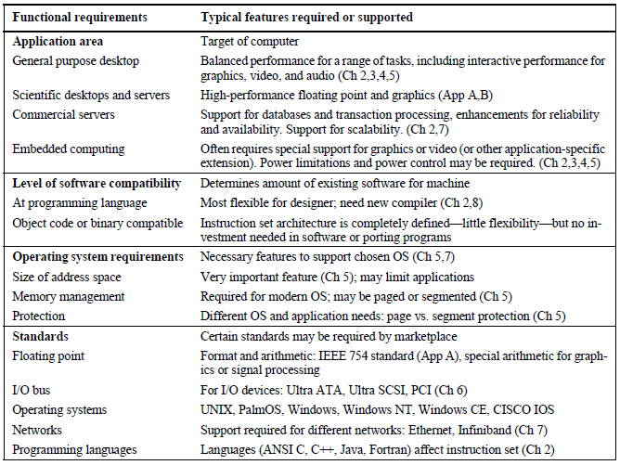
功能要求
需要或支持的典型特征

Slide 37
1.4 Measuring and Reporting Performance
When we say one computer is faster than another, what do we mean? 快的涵义？
Computer user consider: a computer is faster when a program runs in less time. 用户：程序运行时间短
Response time (响应时间)： the time between the start and the completion of an event—also referred to as execution time (执行时间).
Computer center manager consider: a computer is faster when it completes more jobs in an hour. 计算机中心经理：在一小时内做更多工作
Throughput (吞吐量): the total amount of work done in a given time.
The key measurement is time: the computer that performs the same amount of work in the least time is the fast.

Slide 38
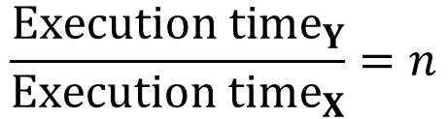
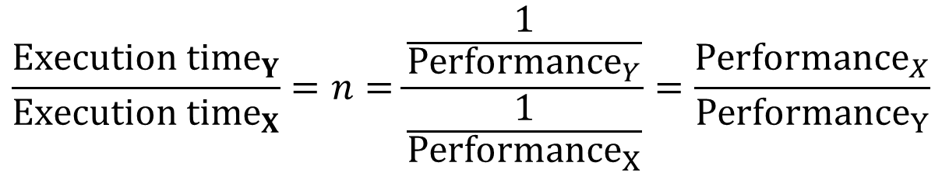
1.4 Measuring and Reporting Performance
Tips: Comparing design alternatives:
“X is faster than Y” mean that the response time is lower on X than on Y. X比Y快的涵义
“X is n times faster than Y” mean: X比Y快n倍
$$\frac{{Execution time}_{Y}}{{Execution time}_{X}}=n$$
Since execution time is the reciprocal of performance: 执行时间是性能的倒数
$$\frac{{Execution time}_{Y}}{{Execution time}_{X}}=n=\frac{\frac{1}{{Performance}_{Y}}}{\frac{1}{{Performance}_{X}}}=\frac{{Performance}_{X}}{{Performance}_{Y}}$$

Slide 39
1.4 Measuring and Reporting Performance
Measuring Performance 测量性能
Response time (响应时间) or elapsed time or wall-clock time:
The latency to complete a task, including disk accesses, memory accesses, input/output activities, operating system overhead. 计算机完成某一任务所花费的全部时间，包括磁盘访问、存储器访问、输入输出、操作系统开销等。
With multiprogramming the CPU works on another program while waiting for I/O and may not necessarily minimize the elapsed time of one program. 在计算机内存中间同时存放几道相互独立的程序，相互穿插运行，因此一般不必要单单减少某个程序的执行时间。

Slide 40
1.4 Measuring and Reporting Performance
Measuring Performance 测量性能
CPU time (CPU时间)： the time CPU is computing, not including the time waiting for I/O or running other programs. CPU执行所给定的程序所花费的时间，不包括含I/O等待时间以及运行其他程序的时间。
can be further divided into:
User CPU time: the CPU time spent in the program, called user CPU time (用户CPU时间) (program).用户程序所耗费的CPU时间。
System CPU time: the CPU time spent in the operating system performing tasks requested by the program, called system CPU time (系统CPU时间) (OS).用户程序运行期间操作系统耗费的时间。
示例： 90.7u 12.9s 2:39 65%

Slide 41
1.4 Measuring and Reporting Performance
Measuring Performance 测量性能
CPU time (CPU时间)： the time CPU is computing, not including the time waiting for I/O or running other programs. CPU执行所给定的程序所花费的时间，不包括含I/O等待时间以及运行其他程序的时间。
示例： 90.7u 12.9s 2:39 65%
P1
P2

Slide 42
1.4 Measuring and Reporting Performance
Choosing Programs to Evaluate Performance
选择程序来评估性能
♦ Four levels of programs listed below in decreasing order of accuracy of prediction. 四个层次的程序.
Real applications 真实应用
Programs that solve real problems.
Examples: compilers for C, text-processing software like Word, and other applications like Photoshop.
Real applications have input, output, and options that a user can select when running the program. 有输入、输出、可选项

Slide 43
1.4 Measuring and Reporting Performance
Choosing Programs to Evaluate Performance
选择程序来评估性能
2. Kernels 核心程序
extract small, key pieces from real programs and use them to evaluate performance. 从真实程序中选出的关键代码段构成的小程序。
Unlike real programs, no user would run kernel programs, for they exist solely to evaluate performance. 无实际用途，只用于评估性能。
Kernels are best used to isolate performance of individual features of a machine to explain the reasons for differences in performance of real programs. 最便于辨析出机器单个特性的性能。

Slide 44
1.4 Measuring and Reporting Performance
Choosing Programs to Evaluate Performance
选择程序来评估性能
3. Toy benchmarks 玩具测试基准/小基准程序
typically between 10 and 100 lines of code and produce a result the user already knows. 10-100行的代码，运行结果已知。
Programs like Puzzle, and Quicksort are popular because they are small, easy to type, and run on almost any computer. 小，易于键入，可运行于几乎所有计算机。

Slide 45
1.4 Measuring and Reporting Performance
Choosing Programs to Evaluate Performance
选择程序来评估性能
4. Synthetic benchmarks 合成测试基准
Similar in philosophy to kernels, synthetic benchmarks try to match the average frequency of operations and operands of a large set of programs. 匹配大量程序中操作和操作数的平均频率。
No user runs synthetic benchmarks, because they don’t compute anything a user could want. 不会有用户运行，因为不会产生任何用户需要的结果。

Slide 46
1.4 Measuring and Reporting Performance
Benchmark Suites 基准测试程序集
♦ Put together collections of benchmarks to measure the performance of processors with a variety of applications. 是一个有各种应用的组合
A key advantage of such suites is that the weakness of one benchmark is lessened by the presence of other benchmarks. 优劣互补，能够比较全面地反映计算机在各方面的处理性能。
Benchmark suits are made of collections of programs, some of which may be kernels, but many of which are typically real programs. 有些是核心程序, 但很多是真实程序。
SPEC-The Standard Performance Evaluation Corporation

Slide 47
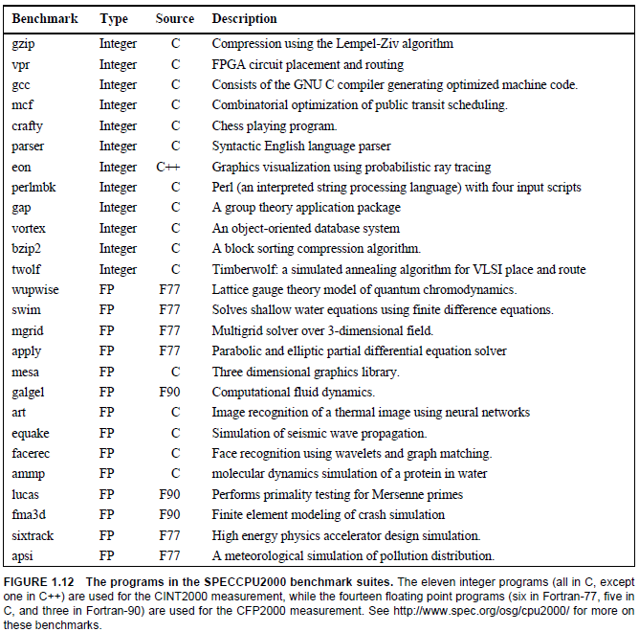

Slide 48
1.4 Measuring and Reporting Performance
Reporting Performance Results 报告性能结果
The guiding principle of reporting performance measurements should be reproducibility (可重现性).
A SPEC benchmark report requires:
a fairly complete description of the machine
the compiler flags
the publication of both the baseline and optimized results
the actual performance times, shown both in tabular form and as a graph.

Slide 50
Computer Architecture 计算机体系结构
School of Computer and Information Technology Beijing Jiaotong Univeristy
Yi Tian

Slide 51
课程概况
1. 共48学时(24次课)。其中课堂讲授32学时(18次课左右)，实验16学时(6次课左右)。
2. 平时包括考勤、课堂表现、测验、上机作业。
3. 最终有期末考试，开卷。英文试卷。
4. 考核方式：平时约50%，期末约50%。
5. 要求尽量读懂教材的英文原文。
6. 联系方式：
①课程平台： https://bksy.bjtu.edu.cn/index.html
②tianyi@bjtu.edu.cn。注意：务必标上你的学号，姓名。
③课程微信群。

Slide 52
课程概况
课程微信群。重要！！！
群备注：姓名-学号，例如：张三-11112222

Slide 53
1.1 Layers of Computer systems
Application Language Machine M5 应用语言机
High-Level Language Machine M4 高级语言机
Assembly Language Machine M3 汇编语言机
Operating System Machine M2 操作系统机
Conventional Machine M1 传统机
Microprogram Machine M0 微程序机

Slide 54
1.2 Computer Architecture and Implementation
软件
指令集（Instruction set）
硬件
经典计算机体系结构概念的实质是计算机系统中软硬件界面的确定，其界面之上的是软件的功能，界面之下的是硬件和固件的功能。“指令集结构”

Slide 55
1.2 Computer Architecture and Implementation
Summary----Computer Architecture:
Now, Genuine Computer Architecture: Designing the Organization and Hardware to Meet Goals and Functional Requirements.
广义（现代）的计算机体系结构的概念，它除了包括经典的计算机体系结构的概念范畴（指令集结构），体系结构设计也包括对组织和硬件的设计以满足设计目标和功能需求。
Computer Architecture：
Instruction set, Organization, Hardware

Slide 56
1.4 Measuring and Reporting Performance
When we say one computer is faster than another, what do we mean? 快的涵义？
Computer user consider: a computer is faster when a program runs in less time. 用户：程序运行时间短
Response time (响应时间)： the time between the start and the completion of an event—also referred to as execution time (执行时间).
Computer center manager consider: a computer is faster when it completes more jobs in an hour. 计算机中心经理：在一小时内做更多工作
Throughput (吞吐量): the total amount of work done in a given time.
The key measurement is time: the computer that performs the same amount of work in the least time is the fast.

Slide 57
1.4 Measuring and Reporting Performance
Measuring Performance 测量性能
CPU time (CPU时间)： the time CPU is computing, not including the time waiting for I/O or running other programs. CPU执行所给定的程序所花费的时间，不包括含I/O等待时间以及运行其他程序的时间。
can be further divided into:
User CPU time: the CPU time spent in the program, called user CPU time (用户CPU时间) (program).用户程序所耗费的CPU时间。
System CPU time: the CPU time spent in the operating system performing tasks requested by the program, called system CPU time (系统CPU时间) (OS).用户程序运行期间操作系统耗费的时间。
示例： 90.7u 12.9s 2:39 65%

Slide 58
1.4 Measuring and Reporting Performance
Choosing Programs to Evaluate Performance
选择程序来评估性能
♦ Four levels of programs listed below in decreasing order of accuracy of prediction. 四个层次的程序.
Real applications 真实应用
Kernels 核心程序
Toy benchmarks 玩具测试基准/小基准程序
Synthetic benchmarks 合成测试基准
Benchmark Suites 基准测试程序集

Slide 59
1.4 Measuring and Reporting Performance
Comparing and Summarizing Performance
比较和总结性能
♦ What is the fair way to summarize relative performance of a collection of programs? 什么是公平的方法?
For example, two articles on summarizing performance in the same journal took opposing points of view. 观点不同.
For example:
 | Computer A | Computer B | Computer C
Program P1 (secs) | 1 | 10 | 20
Program P2 (secs) | 1000 | 100 | 20
Total time (secs) | 1001 | 110 | 40

Slide 60
1.4 Measuring and Reporting Performance
Comparing and Summarizing Performance
比较和总结性能
For example:
 | Computer A | Computer B | Computer C
Program P1 (secs) | 1 | 10 | 20
Program P2 (secs) | 1000 | 100 | 20
Total time (secs) | 1001 | 110 | 40
The following statements hold:
A is 10 times faster than B for program P1. A比B快10倍
B is 10 times faster than A for program P2. B比A快10倍
A is 20 times faster than C for program P1. A比C快20倍
C is 50 times faster than A for program P2. C比A快50倍
B is 2 times faster than C for program P1. B比C快2倍
C is 5 times faster than B for program P2. C比B快5倍
The relative performance of A,B, C is unclear. 结论不明

Slide 61
1.4 Measuring and Reporting Performance
Total Execution Time: A Consistent Summary Measure
总体执行时间
 | Computer A | Computer B | Computer C
Program P1 (secs) | 1 | 10 | 20
Program P2 (secs) | 1000 | 100 | 20
Total time (secs) | 1001 | 110 | 40
Solution: If the workload consisted of running programs P1 and P2 an equal number of times. The simplest approach to summarizing relative performance is to use the total execution time of the two programs.
B is 9.1 times faster than A.
C is 25 times faster than A.
C is 2.75 times faster than B.
This summary tracks execution time, our final measure of performance. 执行时间, 最终性能度量

Slide 62
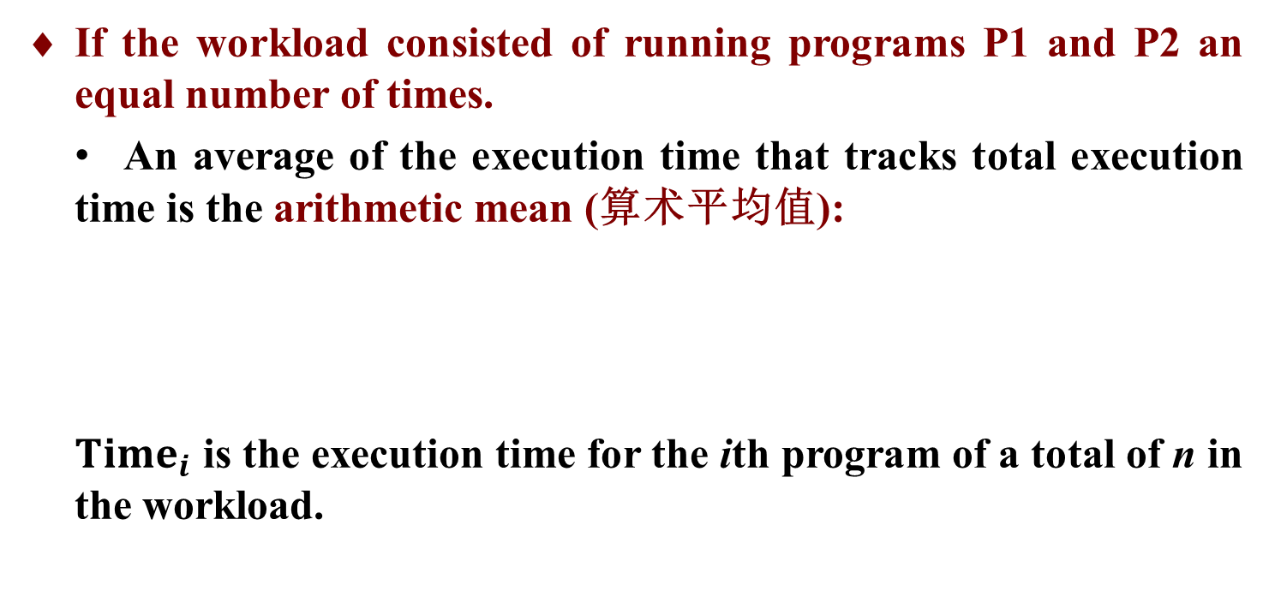
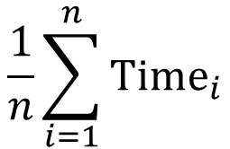
1.4 Measuring and Reporting Performance
Total Execution Time: A Consistent Summary Measure
总体执行时间
If the workload consisted of running programs P1 and P2 an equal number of times.
An average of the execution time that tracks total execution time is the arithmetic mean (算术平均值):
${Time}_{i}$ is the execution time for the ith program of a total of n in the workload.
$$\frac{1}{n}\sum_{i=1}^{n}{{Time}_{i}}$$

Slide 63
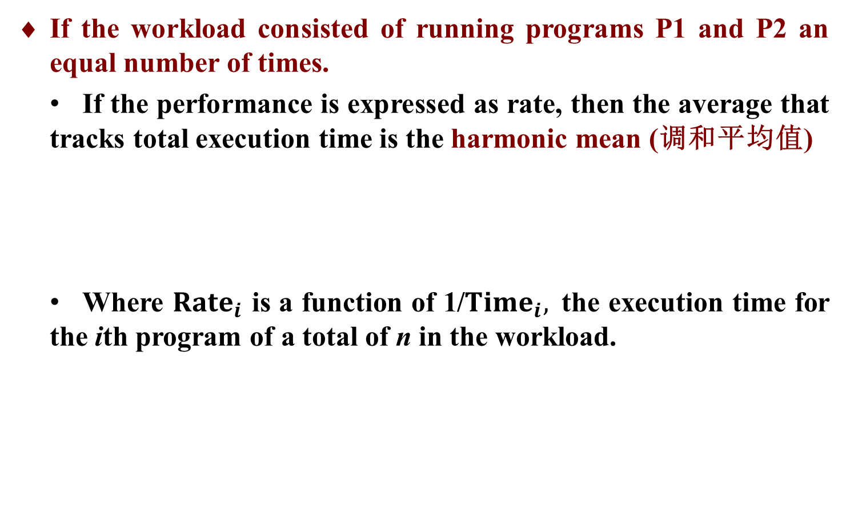
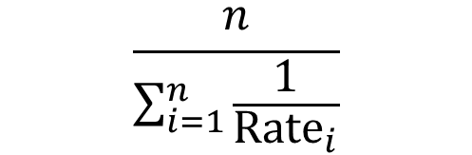
1.4 Measuring and Reporting Performance
Total Execution Time: A Consistent Summary Measure
总体执行时间
If the workload consisted of running programs P1 and P2 an equal number of times.
If the performance is expressed as rate, then the average that tracks total execution time is the harmonic mean (调和平均值)
Where ${Rate}_{i}$ is a function of 1/${Time}_{i},$the execution time for the ith program of a total of n in the workload.
$$\frac{n}{\sum_{i=1}^{n}{\frac{1}{{Rate}_{i}}}}$$

Slide 64
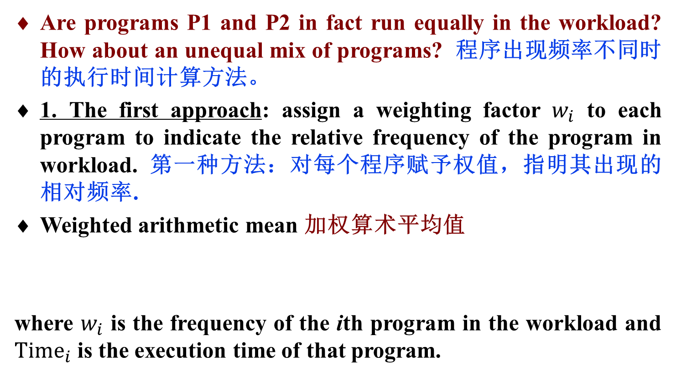
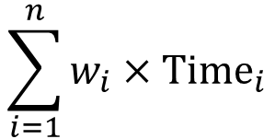
1.4 Measuring and Reporting Performance
Total Execution Time: A Consistent Summary Measure
总体执行时间
Are programs P1 and P2 in fact run equally in the workload? How about an unequal mix of programs? 程序出现频率不同时的执行时间计算方法。
1. The first approach: assign a weighting factor $w_{i}$ to each program to indicate the relative frequency of the program in workload. 第一种方法：对每个程序赋予权值，指明其出现的相对频率.
Weighted arithmetic mean 加权算术平均值
where $w_{i}$ is the frequency of the ith program in the workload and ${Time}_{i}$ is the execution time of that program.
$$\sum_{i=1}^{n}{w_{i}×{Time}_{i}}$$

Slide 65
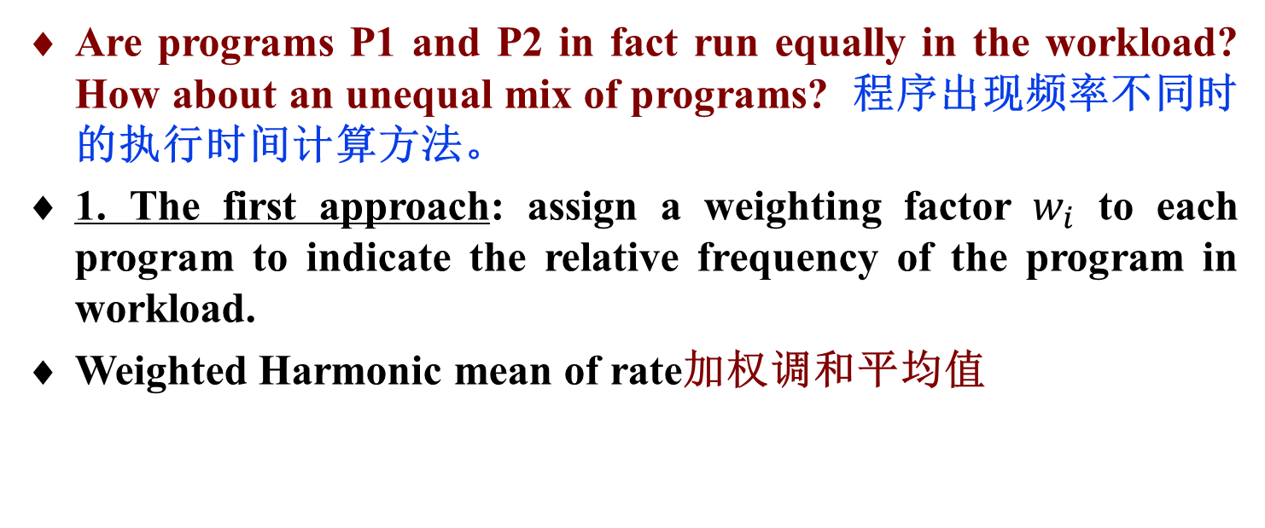
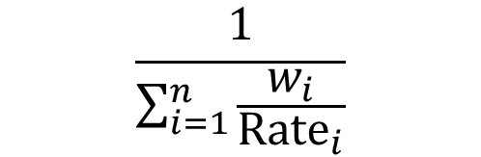
1.4 Measuring and Reporting Performance
Total Execution Time: A Consistent Summary Measure
总体执行时间
Are programs P1 and P2 in fact run equally in the workload? How about an unequal mix of programs? 程序出现频率不同时的执行时间计算方法。
1. The first approach: assign a weighting factor $w_{i}$ to each program to indicate the relative frequency of the program in workload.
Weighted Harmonic mean of rate加权调和平均值
$$\frac{1}{\sum_{i=1}^{n}{\frac{w_{i}}{{Rate}_{i}}}}$$

Slide 66
1.4 Measuring and Reporting Performance
Total Execution Time: A Consistent Summary Measure
总体执行时间
2. The second approach: is to normalize execution times to a reference machine（参考机）and take the average of the normalized execution times.第二种方法：归一化执行时间，再取平均值.
Performance of new programs can be predicted by simply multiplying this number times its performance on the reference machine.实际性能=归一化数×参考机性能

Slide 67
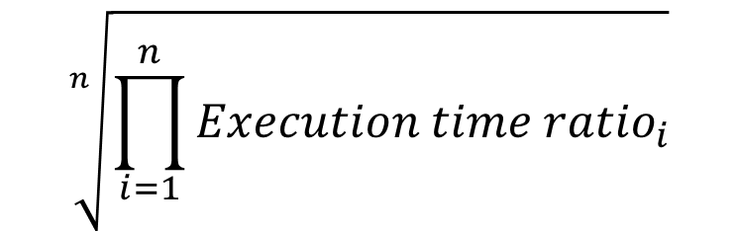
1.4 Measuring and Reporting Performance
Total Execution Time: A Consistent Summary Measure
总体执行时间
Average normalized execution time can be expressed as either an arithmetic or geometric mean. 可采用算数或几何平均值
Geometric mean (几何平均值)
$$\sqrt[n]{\prod_{i=1}^{n}{Execution time {ratio}_{i}}}$$
where Execution time ratio_{i} is the execution time, normalized to the reference machine, for the ith program of a total of n in the workload

Slide 68
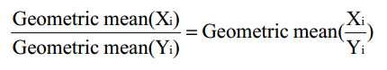
1.4 Measuring and Reporting Performance
Total Execution Time: A Consistent Summary Measure
总体执行时间
Geometric means have a nice property for two samples X_{i} and Y_{i}: 几何平均值的好性质
几何平均值的比率与比率的几何平均值相同
In contrast to arithmetic means, geometric means of normalized execution times are consistent no matter which machine is the reference. 无论采用哪个机器作为参考机，归一化执行时间的几何平均值都是一致的。

Slide 69


1.4 Measuring and Reporting Performance
Total Execution Time: A Consistent Summary Measure
总体执行时间
Example：
 | Computer A | Computer B | Computer C
Program P1 (secs) | 1 | 10 | 20
Program P2 (secs) | 1000 | 100 | 20
Total time (secs) | 1001 | 110 | 40

Slide 70
1.4 Measuring and Reporting Performance
Explanation：
♦ The arithmetic mean performance varies depending on which is the reference machine
In column 2, B’s execution time is five times longer than A’s, although the reverse is true in column 4.
In column 3, C is slowest, but in column 9, C is fastest.
♦ The geometric means are independent of normalization
A and B have the same performance, and the execution time of C is 0.63 of A or B (1/1.58 is 0.63).
However, the total execution time of A is 10 times longer than that of B, and B in turn is about 3 times longer than C.
As a point of interest, the relationship between the means of the same set of numbers is always:
Harmonic mean ≤ geometric mean ≤ arithmetic mean

Slide 71
1.4 Measuring and Reporting Performance
Normalized Execution Time and the Pros and Cons of Geometric Means
归一化执行时间，以及几何平均值的优劣
♦Advantage: geometric mean is independent of the running times of individual programs, and it doesn’t matter which machine is used to normalize. 与各个程序运行时间无关，与采用哪一个机器进行归一化无关
♦Drawback: geometric means violate our fundamental principle of performance measurement --- do not predict execution time. 违反了性能测量的基本原理, 不预测时间

Slide 72
1.5 Quantitative Principles of Computer Design
This section includes:
1.5.1 Make the Common Case Fast
（大概率事件优先原则）
1.5.2 Amdahl’s Law （阿姆达尔定律） 1.5.3 The CPU Performance Equation（CPU性能方程）
1.5.4 Locality of Reference (访问的局部性原理)

Slide 73
1.5 Quantitative Principles of Computer Design
Make Common Case Fast 加快经常性事件原则
In making a design trade-off, favor the frequent case over the infrequent case.
对于大概率事件（最常见的事件），赋予它优先的处理权和资源使用权，以获得全局的最优结果。
The most important principle of computer design.
The frequent case is often simpler and can be done faster than the infrequent case

Slide 74
1.5 Quantitative Principles of Computer Design
Make Common Case Fast 加快经常性事件原则
Example: When adding two numbers in the processor, we can expect overflow to be a rare circumstance and can therefore improve performance by optimizing the more common case of no overflow.
无溢出
无溢出
无溢出
无溢出
无溢出
无溢出
加法运算
无溢出
无溢出
无溢出
无溢出
无溢出
无溢出
无溢出
无溢出
无溢出
溢出
无溢出
无溢出
无溢出
Thinking: What the frequent case is? How much performance can be improved by making that case faster?

Slide 75
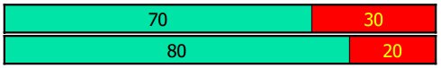
1.5 Quantitative Principles of Computer Design
Amdahl’s Law 阿姆达尔定律
Amdahl’s Law: The performance improvement to be gained from using some faster mode of execution is limited by the fraction of the time the faster mode can be used.
加快某部件执行速度所获得的系统性能提高（加速比）与该部件在系统中的总执行时间的比例有关。
The performance gain obtained by improving some portion of a computer can be calculated using Amdahl’s Law.
Amdahl’s Law defines the speedup (加速比) that can be gained by using a particular feature.

Slide 76
1.5 Quantitative Principles of Computer Design
Amdahl’s Law 阿姆达尔定律
Speedup (加速比) :
or

Slide 77
1.5 Quantitative Principles of Computer Design
Amdahl’s Law 阿姆达尔定律
Speedup_{overall} depends on two factors: 加速比依赖于两个因素
1. The fraction of the computation time in the original machine that can be converted to take advantage of the enhancement.
可改进部分在原系统执行时间中所占的比例。
可改进比例Fe: Fraction_{enhanced}≤1
2. The improvement gained by the enhanced execution mode. That is, how much faster the task would run if the enhanced mode were used for the entire program.
可改进部分改进后的性能提高。
部件加速比Se: Speedup_{enhanced}>1

Slide 78
1.5 Quantitative Principles of Computer Design
Amdahl’s Law 阿姆达尔定律
Speedup_{overall} depends on two factors: 加速比依赖于两个因素
1. 可改进比例Fe: Fraction_{enhanced}
2. 部件加速比Se: Speedup_{enhanced}
T₁
T₂
T_{o}
T_{e}

Slide 79
1.5 Quantitative Principles of Computer Design
Amdahl’s Law 阿姆达尔定律
Example:
If 40 seconds of the execution time of a program that takes 100 seconds in total can use an enhancement, the fraction is 40/100.
This value, which we call Fraction_{enhanced}, is always less than or equal to 1.
可改进比例Fe: Fraction_{enhanced} ≤1
If the enhanced mode takes 4 seconds for a portion of the program, while it is 40 seconds in the original mode, the improvement is 40/4 or 10.
This is Speedup_{enhanced}, which is greater than 1.
部件加速比Se: Speedup_{enhanced}>1

Slide 80
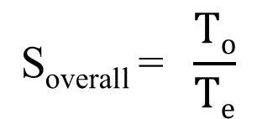
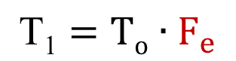

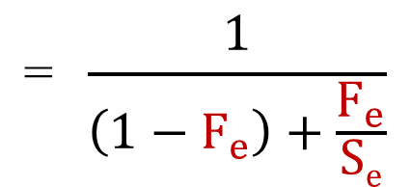
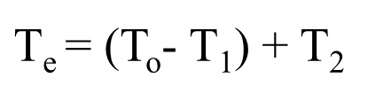
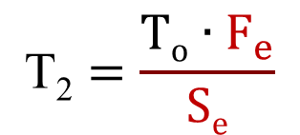
1.5 Quantitative Principles of Computer Design
Amdahl’s Law 阿姆达尔定律
The overall speedup of system is the ratio of the execution times:
$$\text{S}\text{overall} \text{=} \frac{To}{Te}$$
$$\text{=} \frac{1}{\left(1−F_{e}\right)+\frac{F_{e}}{Se}}$$
$$\text{T}\text{2}=\frac{To∙F_{e}}{Se}$$
$$\text{T}\text{1}=To∙F_{e}$$
$$\text{=}\left(\text{T}\text{o}−To∙F_{e}\right)+\frac{To∙F_{e}}{Se} \text{=} \text{T}\text{o}∙\left[\left(1−F_{e}\right)+\frac{F_{e}}{Se}\right]$$
$\text{T}\text{e}$= (T_{o}- T₁) + T₂

Slide 81
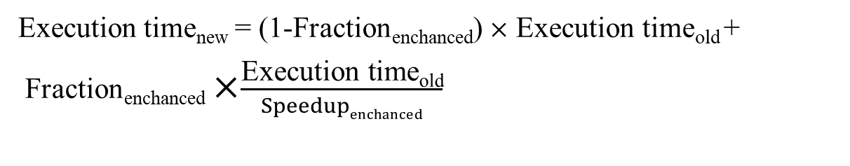
1.5 Quantitative Principles of Computer Design
Amdahl’s Law 阿姆达尔定律
The new Execution time 改进后程序的总执行时间
Execution time_{new} = (1-Fraction_{enchanced}) ✕ Execution time_{old} +
Fraction_{enchanced} ✕$\frac{\text{Execution} \text{time}\text{old}}{Speedupenchanced}$
The overall speedup is the ratio of the execution times
系统加速比

Slide 82
1.5 Quantitative Principles of Computer Design
Amdahl’s Law 阿姆达尔定律
Example: Suppose that we are considering an enhancement that runs 10 times faster than the original machine, but is only usable 40% of the time. What is the overall speedup gained by incorporating the enhancement?

Slide 83
1.5 Quantitative Principles of Computer Design
Amdahl’s Law 阿姆达尔定律
Example: Implementations of floating-point square root (FPSQR) vary significantly in performance. Suppose FPSQR is responsible for 20% of the execution time of a critical benchmark.
One proposal is to add FPSQR hardware that will speed up this operation by a factor of 10.一种方法，用硬件实现FPSQR。
The other alternative is just to try to make all FP instructions run faster; FP instructions are responsible for a total of 50% of the execution time. The design team can make all FP instructions run two times faster with the same effort.另一种方法，使所有浮点运算速度加快。
Compare two design alternatives.

Slide 84
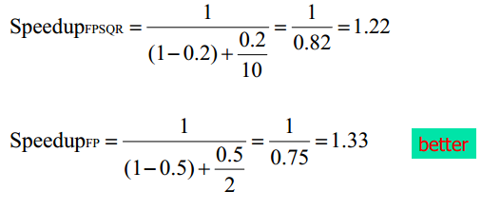
1.5 Quantitative Principles of Computer Design
Amdahl’s Law 阿姆达尔定律
Answer:
So, improving the performance of the FP operations overall is better.

Slide 85

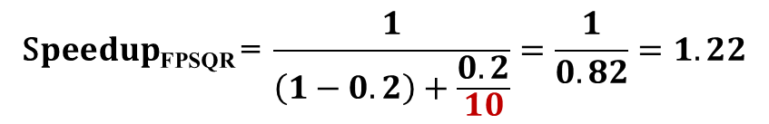
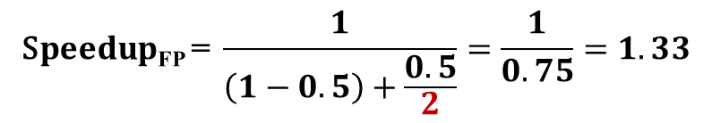
1.5 Quantitative Principles of Computer Design
Amdahl’s Law 阿姆达尔定律
Thinking: Why improving FP is better?
$$\text{S}peedup\text{FPSQR} \text{=} \frac{1}{\left(1−0.2\right)+\frac{0.2}{10}}=\frac{1}{0.82}=1.22$$
$$\text{S}peedup\text{FP} \text{=} \frac{1}{\left(1−0.5\right)+\frac{0.5}{2}}=\frac{1}{0.75}=1.33$$
Reason: Because of the higher frequency (Make the Common Case Fast).
Original process:
Make common 2x faster:
Make uncommon 10x faster:

Slide 86
1.5 Quantitative Principles of Computer Design
Amdahl’s Law 阿姆达尔定律
Amdahl’s Law expresses the law of diminishing returns (回报递减法则): The incremental improvement in speedup gained by an additional improvement in just a portion of the computation diminishes as improvements are added. 如果仅仅对计算机的一部分进行改进，则改进越多系统获得的效果越小。

Slide 87
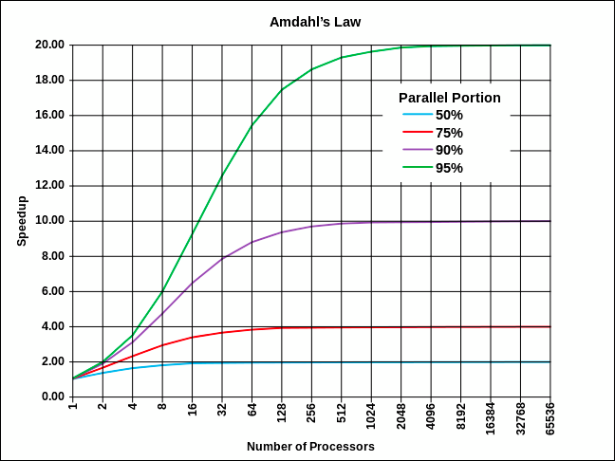
1.5 Quantitative Principles of Computer Design
Amdahl’s Law 阿姆达尔定律
Diminishing returns (回报递减法则):
Fe=95%

Slide 88
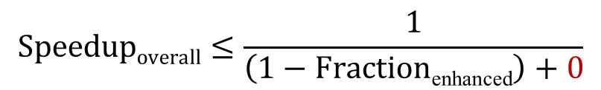

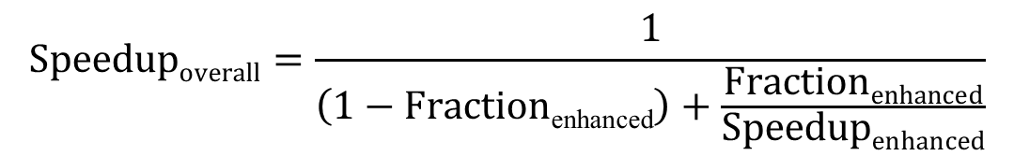
1.5 Quantitative Principles of Computer Design
Amdahl’s Law 阿姆达尔定律
An important corollary of Amdahl’s Law : if an enhancement is only useable for a fraction of a task, we can’t speed up the task by more than the reciprocal of 1 minus that fraction. 如果只针对整个任务的一部分进行优化，则所获得的加速比不大于1/(1-可改进比例)
$$Speedupoverall=\frac{1}{\left(1−\text{Fraction}\text{enhan}\text{ced}\right)+\frac{Fractionenhanced}{Speedupenhanced}}$$
$$∞$$
$$Speedupoverall≤\frac{1}{\left(1−\text{Fraction}\text{enhan}\text{ced}\right)+0}$$

Slide 89
1.5 Quantitative Principles of Computer Design
Amdahl’s Law 阿姆达尔定律
Example: Suppose FP is responsible for 10% of the execution time of a critical benchmark. We want to improve the performance of FP. What’s the maximum speedup of the system we can get?

Slide 90
1.5 Quantitative Principles of Computer Design
The CPU Performance Equation CPU性能方程
Essentially all computers are constructed using a clock running at a constant rate. These discrete time events are called ticks, clock ticks, clock periods, clocks, cycles, or clock cycles.
Computer designers refer to the time of a clock period by its duration (e.g., 1 ns) or by its rate (e.g., 1 GHz).
CPU time for a program can then be expressed as:

Slide 91
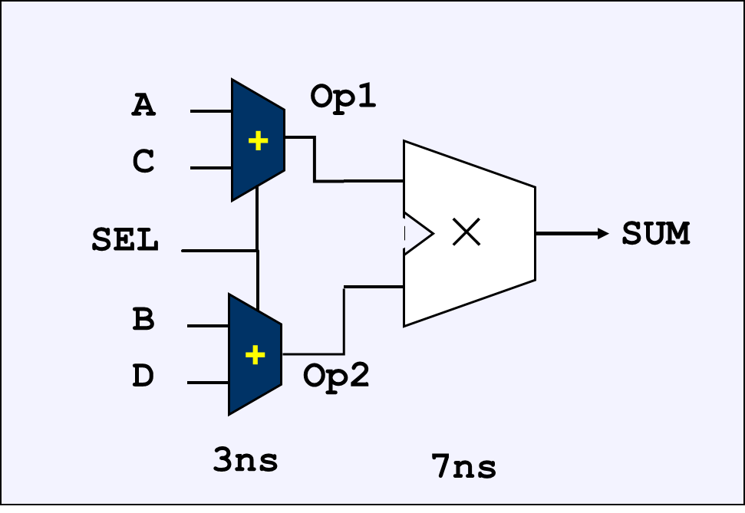
1.5 Quantitative Principles of Computer Design
The CPU Performance Equation CPU性能方程
Example:

Slide 92
1.5 Quantitative Principles of Computer Design
The CPU Performance Equation CPU性能方程
We can also count the number of instructions executed---the instruction path length or instruction count (IC--指令数).
CPI (Cycles Per Instruction)：If we know the number of clock cycles and the instruction count, we can calculate the average number of clock cycles per instruction (CPI--单条指令的时钟周期数).

Slide 93
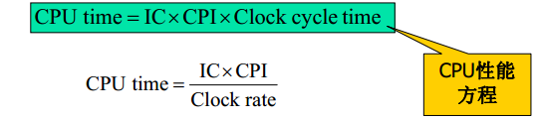
1.5 Quantitative Principles of Computer Design
The CPU Performance Equation CPU性能方程
This allows us to use CPI in the execution time formula：
Expanding the first formula as:

Slide 94
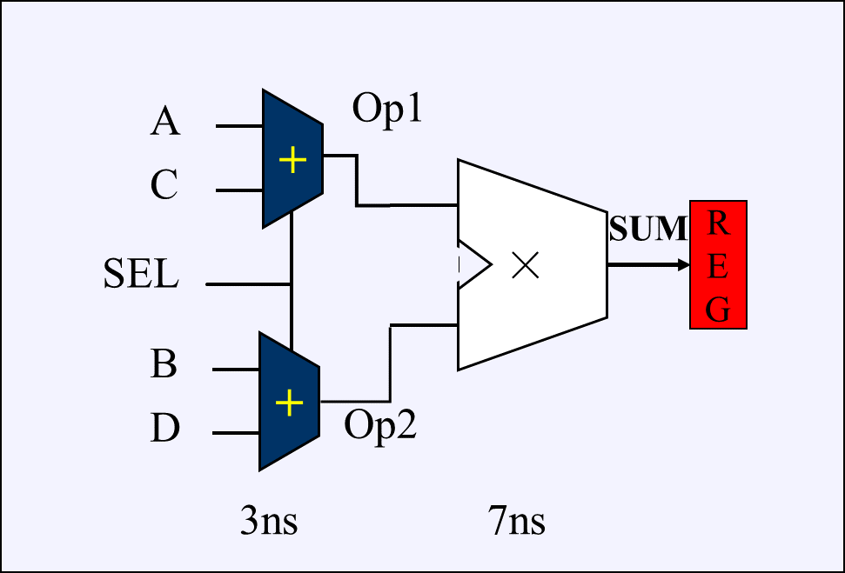
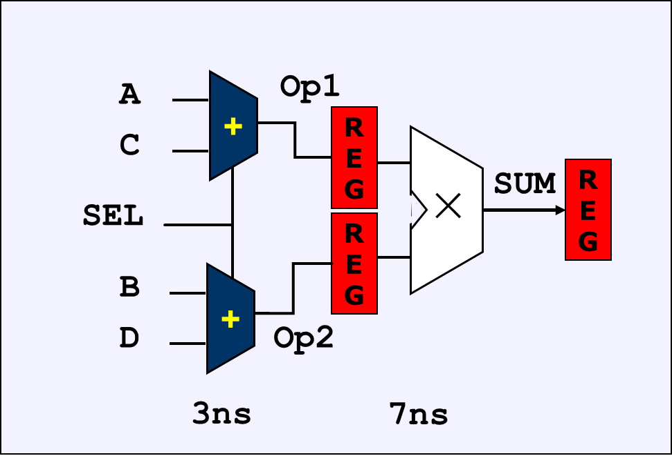
1.5 Quantitative Principles of Computer Design
The CPU Performance Equation CPU性能方程
CPU performance is dependent upon: clock cycle (or rate), CPI, and IC:
Clock cycle time -- Hardware technology and organization
反映了计算机实现技术，生产工艺和计算机组织。

Slide 95
1.5 Quantitative Principles of Computer Design
The CPU Performance Equation CPU性能方程
CPU performance is dependent upon: clock cycle (or rate), CPI, and IC:
Clock cycle time -- Hardware technology and organization
反映了计算机实现技术，生产工艺和计算机组织。
CPI -- Organization and ISA (Instruction Set Architecture)
反映了计算机组织和计算机指令集结构
Instruction count -- ISA and compiler technology
反映了计算机指令集的结构和编译技术

Slide 96
1.5 Quantitative Principles of Computer Design
The CPU Performance Equation CPU性能方程
CPU performance is dependent upon: clock cycle (or rate), CPI, and IC:
Clock cycle time -- Hardware technology and organization
CPI -- Organization and ISA (Instruction Set Architecture)
Instruction count -- ISA and compiler technology
But it is difficult to change one parameter in isolation from others because the basic technologies involved are interdependent. Luckily, many improvement techniques primarily improve one component with small or predictable impacts on the other two. 很难改变一个参数而不影响其它参数。幸好，很多技术在改进一个部分时，对于其他部分影响很小或影响可预测 。

Slide 97
1.5 Quantitative Principles of Computer Design
The CPU Performance Equation CPU性能方程
Sometimes it is useful in designing the CPU to use (考虑每种指令):
This form can be used to express CPU time as:
where IC_{i} represents number of times instruction i is executed in a program and CPI_{i} represents the average number of clock cycles for instruction i.

Slide 98
1.5 Quantitative Principles of Computer Design
The CPU Performance Equation CPU性能方程
Example：Suppose we have the following measurements:
* Frequency of FP operations = 25%
* Average CPI of FP operations = 4.0
* Average CPI of other instructions = 1.33
* Frequency of FPSQR= 2%
* CPI of FPSQR = 20
Assume that the two design alternatives are
(1) to reduce the CPI of FPSQR to 2
(2) to reduce the average CPI of all FP operation to 2.
Compare these two design alternatives using the CPU performance equation.

Slide 99
1.5 Quantitative Principles of Computer Design
The CPU Performance Equation CPU性能方程
Answer: First, observe that only the CPI changes; the clock rate and instruction count remain identical. We start by finding the original CPI with neither enhancement:只有CPI变化了(clock和IC未变)
We can compute the CPI for the enhanced FPSQR by subtracting the cycles saved from the original CPI:

Slide 100
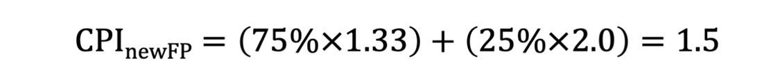
1.5 Quantitative Principles of Computer Design
The CPU Performance Equation CPU性能方程
We compute the CPI for the enhancement of all FP instructions:
The CPI of overall FP enhancement is lower, its performance will be better. Specifically, the speedup for the overall FP enhancement is:

Slide 101
1.5 Quantitative Principles of Computer Design
The CPU Performance Equation CPU性能方程
Another solution:
2. How to use Amdahl’s law to compare?
先计算各指令执行时间所占的比例，再利用Amdahl’s定律

Slide 102
1.5 Quantitative Principles of Computer Design
The CPU Performance Equation CPU性能方程
Measuring the Components of CPU Performance
测量CPU性能的各组成部分
♦ To use the CPU performance equation, we need the measurements of the individual components. 需要测量性能的各组成部分
1. To determine the clock cycle:
Low-level tools: timing estimators or timing verifiers, are used for a completed design. 用时延估计器或时延验证器
For a design that is not completed, by examining critical paths. 未完成的设计: 考察关键路径

Slide 103
1.5 Quantitative Principles of Computer Design
The CPU Performance Equation CPU性能方程
Measuring the Components of CPU Performance
测量CPU性能的各组成部分
2. Measuring the instruction count:
compiler together with tools that measure the instruction set behavior. 编译器及测量指令集行为的工具
For a compiled version of a program, there are two major methods to obtain IC.
First: by instruction set simulator that interprets the instructions—slow but can measure almost any aspect of instruction set behavior accurately. 指令集模拟器：慢, 但能精确地测量指令集行为的几乎所有方面
Second: uses execution-based monitoring. The binary program is modified to include instrumentation code —very fast, since program is executed, rather than interpreted. 用基于执行的监视：修改程序（插桩代码），快。

Slide 104
1.5 Quantitative Principles of Computer Design
The CPU Performance Equation CPU性能方程
Measuring the Components of CPU Performance
测量CPU性能的各组成部分
3. Measuring the CPI:
For simple processors, CPI from a table. 查表
For modern processors use techniques such as pipelining and memory hierarchies: 对于带流水线和存储层次的现代处理器
Designers often use average CPI values, but these average CPIs are computed by measuring the effects of the pipeline and cache structure. 通常使用平均CPI，需考虑流水线和cache结构
it is often useful to separate the component arising from the memory system and the component determined by the pipeline. 流水线和存储系统分别考虑
Thus, we can compute the CPI for instruction i, as:
CPI_{i} = Pipeline CPI_{i} + Memory system CPI_{i}

Slide 105
1.5 Quantitative Principles of Computer Design
The CPU Performance Equation CPU性能方程
Example：we are considering two alternatives for our conditional branch instructions (条件转移指令), as : 条件转移指令有两种设计选择
CPU A: A condition code is set by a compare instruction and followed by a branch that tests the condition code. 先用比较指令置条件码, 然后转移指令检测条件码进行分支
CPU B: A compare is included in the branch. 转移指令中包含比较操作
On both CPUs, conditional branch instruction takes 2 cycles, and all other instructions take 1 clock cycle. 条件转移指令2周期，其他指令1周期
On CPU A, 20% of all instructions executed are conditional branches. Since every branch needs a compare, another 20% of the instructions are compares. CPU A：有20%条件转移指令，相应也就有20%的比较指令
Because CPU A does not have the compare included in the branch, assume that its clock cycle time is 1.25 times faster than that of CPU B. CPU A的时钟比CPU B的快1.25倍
Which CPU is faster? 哪一个更快？
What if CPU A was only 1.1 times faster?

Slide 106

1.5 Quantitative Principles of Computer Design
The CPU Performance Equation CPU性能方程
Example：we are considering two alternatives for our conditional branch instructions (条件转移指令), as : 条件转移指令有两种设计选择
CPU A: A condition code is set by a compare instruction and followed by a branch that tests the condition code. 先用比较指令置条件码, 然后转移指令检测条件码进行分支
CPU B: A compare is included in the branch. 转移指令中包含了比较操作

Slide 107
1.5 Quantitative Principles of Computer Design
The CPU Performance Equation CPU性能方程
On both CPUs, conditional branch instruction takes 2 cycles, and all other instructions take 1 clock cycle. 条件转移指令2周期，其他指令1周期
CPU_{A}
CPU_{B}
其它指令 1
其它指令 1
比较指令 1
分支指令 2
测试分支 2

Slide 108
1.5 Quantitative Principles of Computer Design
The CPU Performance Equation CPU性能方程
On CPU A, 20% of all instructions executed are conditional branches. Since every branch needs a compare, another 20% of the instructions are compares. CPU A：有20%条件转移指令，相应也就有20%的比较指令
CPU_{A}
CPU_{A}
CPU_{B}
CPU_{B}
其它指令
其它指令60%
其它指令
其它指令60%
比较指令
比较指令20%
分支指令
分支指令20%
测试分支
测试分支20%

Slide 109
1.5 Quantitative Principles of Computer Design
The CPU Performance Equation CPU性能方程
Because CPU A does not have the compare included in the branch, assume that its clock cycle time is 1.25 times faster than that of CPU B. CPU A的时钟比CPU B的快1.25倍
Which CPU is faster? 哪一个更快？
What if CPU A was only 1.1 times faster?
CPU_{A}
CPU_{A}
CPU_{B}
CPU_{B}
其它指令
其它指令60%
其它指令
其它指令60%
比较指令
比较指令20%
分支指令
分支指令20%
测试分支
测试分支20%

Slide 110
1.5 Quantitative Principles of Computer Design
The CPU Performance Equation CPU性能方程
Answer:
we can use CPU performance formula:
CPI_{A} = 0.20×2 + 0.80×1 = 1.2
CPU time_{A} = IC_{A}×1.2×Clock cycle time_{A}
Clock cycle time_{B} =1.25×Clock cycle time_{A}
Compares are not executed in CPU B, so 20%/80%=25% instructions are branches：
CPI_{B} = 0.25×2 + 0.75×1 = 1.25
Because, ICB=0.8×ICA. so:
CPU time_{B} = IC_{B}×1.25×Clock cycle time_{B}
= 0.8×IC_{A}×1.25×(1.25×Clock cycle time_{A})
= 1.25×IC_{A}×Clock cycle time_{A} > CPU time_{A}
所以此时A快

Slide 111
1.5 Quantitative Principles of Computer Design
The CPU Performance Equation CPU性能方程
Answer:
If CPU A were only 1.1 times faster, then Clock cycle times is 1.10× Clock cycle timeA and the performance of CPU B is: 如果CPU A只比CPU B快1.1倍
CPU time_{B} = IC_{B}×CPI_{B}×Clock cycle time_{B}
= 0.8×IC_{A}×1.25×(1.10×Clock cycle time_{A})
= 1.10×IC_{A}×Clock cycle time_{A}
< CPU time_{A}
所以此时B快

Slide 112
1.5 Quantitative Principles of Computer Design
Locality of Reference 引用局部性
Locality of Reference: Programs tend to reuse data and instructions they have used recently. 程序倾向于重用刚用过的数据和指令。
A widely held rule of thumb is that a program spends 90% of its execution time in only 10% of the code. 经验：90%的时间运行于10%的程序上
We can predict with reasonable accuracy what instructions and data a program will use in the near future based on its accesses in the recent past. 可根据最近的访问，以合理的精确度预测，未来会用到哪些指令和数据。

Slide 113
1.5 Quantitative Principles of Computer Design
Locality of Reference 引用局部性
程序局部性包括：
程序的时间局部性：程序即将用到的信息很可能就是目前正在使用的信息。
程序的空间局部性：程序即将用到的信息很可能与目前正在使用的信息在空间上相邻或者临近。
磁盘、磁带
DRAM
存储器
层次结构
L2 Cache
L1 Cache
CPU

Slide 114
Computer Architecture 计算机体系结构
School of Computer and Information Technology Beijing Jiaotong Univeristy
Yi Tian

Slide 115
1.5 Quantitative Principles of Computer Design
Make Common Case Fast 加快经常性事件原则
In making a design trade-off, favor the frequent case over the infrequent case.
对于大概率事件（最常见的事件），赋予它优先的处理权和资源使用权，以获得全局的最优结果。
The most important principle of computer design.
The frequent case is often simpler and can be done faster than the infrequent case

Slide 116
1.5 Quantitative Principles of Computer Design
Amdahl’s Law 阿姆达尔定律
Amdahl’s Law: The performance improvement to be gained from using some faster mode of execution is limited by the fraction of the time the faster mode can be used.
加快某部件执行速度所获得的系统性能提高（加速比）与该部件在系统中的总执行时间的比例有关。

Slide 117
1.5 Quantitative Principles of Computer Design
The CPU Performance Equation CPU性能方程
This allows us to use CPI in the execution time formula：
Expanding the first formula as:

Slide 118
1.5 Quantitative Principles of Computer Design
Locality of Reference 引用局部性
程序局部性包括：
程序的时间局部性：程序即将用到的信息很可能就是目前正在使用的信息。
程序的空间局部性：程序即将用到的信息很可能与目前正在使用的信息在空间上相邻或者临近。
磁盘、磁带
DRAM
存储器
层次结构
L2 Cache
L1 Cache
CPU

Slide 119
1.6 Classification of Computer Architecture
Michael Flynn弗林 introduced a classification of various computer architectures based on notions of instruction and data streams.
Flynn’s Classification:
SISD(single instruction stream over a single data stream)
单指令流单数据流
SIMD(single instruction stream over multiple data stream)
单指令流多数据流
MIMD(multiple instruction over multiple data streams)
多指令流多数据流
MISD(multiple instruction streams and a single data stream) 多指令流单数据流

Slide 120
1.6 Classification of Computer Architecture
SISD (single instruction stream over a single data stream)
IS
IS
DS
CU
PU
MU
I/O
CU = Control Unit
PU = Processing Unit
MU = Memory Unit
IS = Instruction Stream
DS = Data Stream

Slide 121
1.6 Classification of Computer Architecture
MISD (multiple instruction streams and a single data stream)
IS
•
•
•
IS
CU1
CU2
•
•
•
CUn
Memory
(Program and data)
IS
IS
IS
DS
DS
DS
PU1
PU2
•
•
•
PUn
I/O
DS

Slide 122
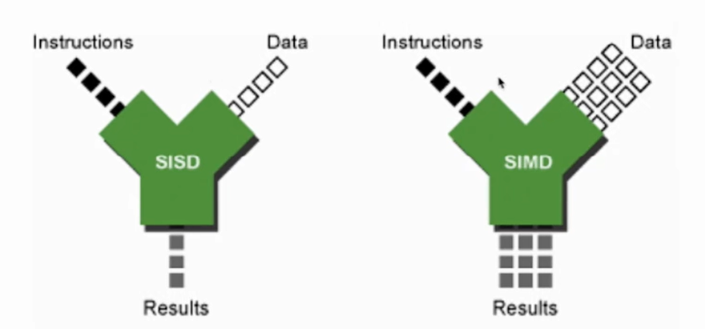
1.6 Classification of Computer Architecture
SIMD (single instruction stream over multiple data stream)
PE1
LM1
DS
DS
IS
•
•
CU
•
•
•
•
DS
DS
PEn
LMn
PE = Processing Element
LM = Local Memory

Slide 123
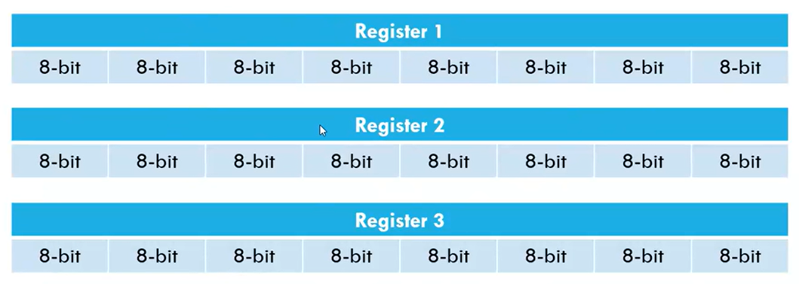
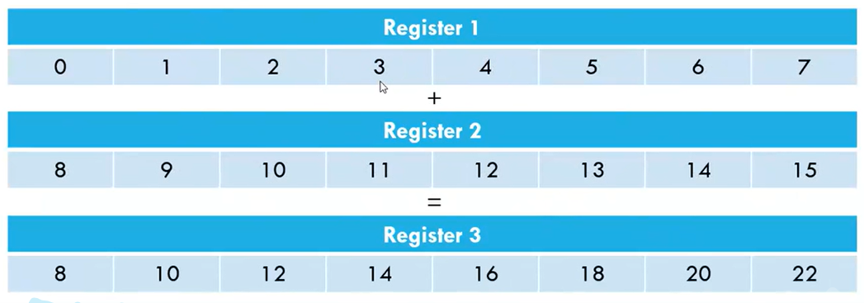

Slide 124
1.6 Classification of Computer Architecture
MIMD (multiple instruction multiple data streams)
IS
Shared
Memory
I/O
CU
PU1
DS
IS
•
•
•
•
•
•
•
•
•
I/O
IS
DS
CU
PUn
IS
CU = Control Unit
PU = Processing Unit
MU = Memory Unit
IS = Instruction Stream
DS = Data Stream

Slide 125
1.6 Classification of Computer Architecture
Most parallel computers built in the past assumed the MIMD model for general-purpose computations.
The SIMD and MISD models are more suitable for special-purpose computations.
For this reason, MIMD is the most popular model, SIMD next, and MISD the least popular model being applied in commercial machines.

